Slide 1

Breast Cancer Wisconsin (Diagnostic) Classification
SIC – AI701
Superviced By : Eng Marwan Hatem
Notes:
Note:
1

Slide 2
Agenda
Team Members
Motivation
Dataset Description
Data Prepressing
Exploratory Data Analysis (EDA)
PCA
Pipeline
Model Selection
Best Models & Final Results
Deployment
Future Enhancements
Samsung Innovation Campus

Slide 3


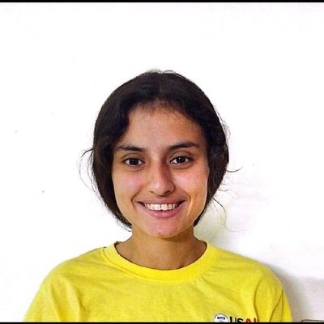

Team Members
Moataz Mohamed
Kirellos Youssef
Lourina Emil
Samsung Innovation Campus

Slide 4
Motivation
Samsung Innovation Campus
Notes:
Note:
2

Slide 5
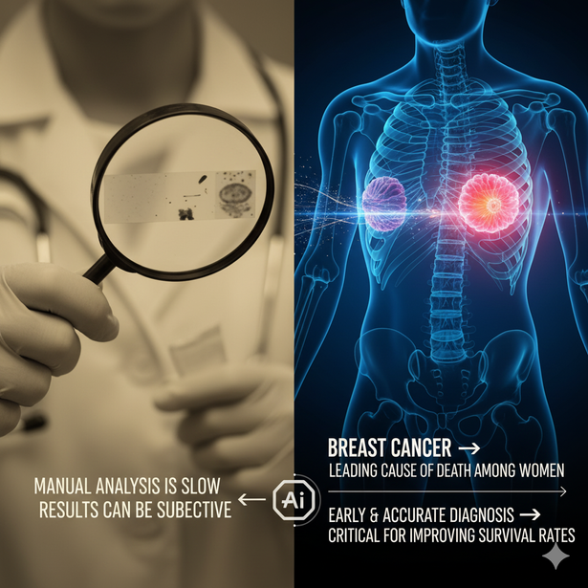
Motivation
Breast cancer → one of the leading causes of death among women
Early & accurate diagnosis → critical for improving survival rates
Challenges:
Manual analysis is slow
Results can be subjective
Samsung Innovation Campus

Slide 6
Dataset Description
Samsung Innovation Campus
Notes:
Note:
2

Slide 7
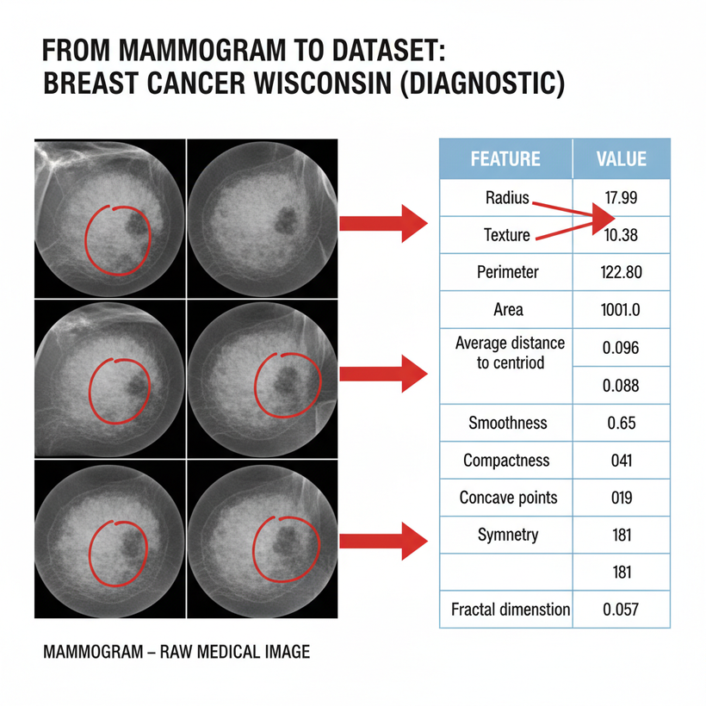
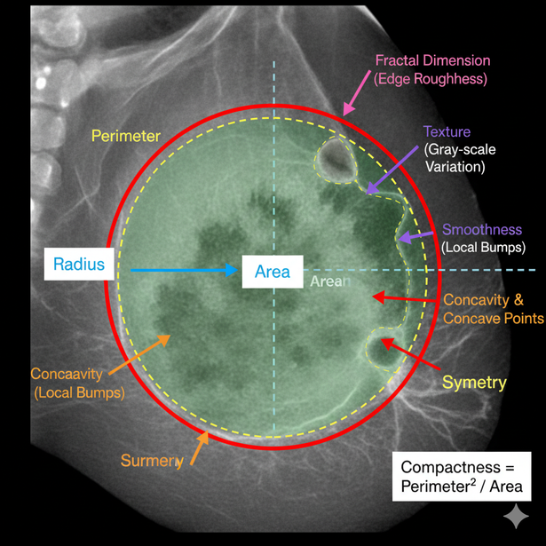
Dataset Description

Slide 8
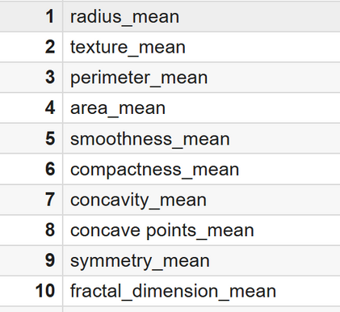
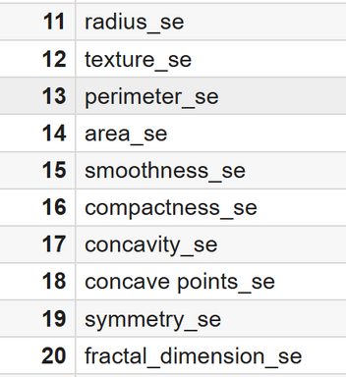
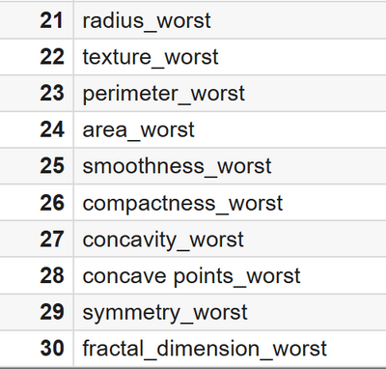
Dataset Description
The number of rows (samples) is 569
The number of columns (Features) is 33:
Target Variable: diagnosis → Malignant (M) or Benign (B)
1 ID column (not useful for modeling) → dropped
1 Empty column (Unnamed: 32) → dropped
30 numeric features:
Mean Features
Std Features
Worst Features

Slide 9
EDA
Samsung Innovation Campus
Notes:
Note:
2

Slide 10
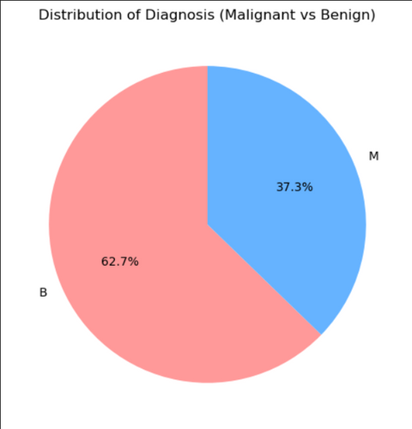
EDA
Class Distribution in the Dataset
Malignant (M): ~37%
Benign (B): ~63%
The dataset is imbalanced.
Misclassifying a malignant tumor as benign is much more dangerous than the reverse.
This imbalance must be handled carefully.
Samsung Innovation Campus
Notes:
Note:
4

Slide 11
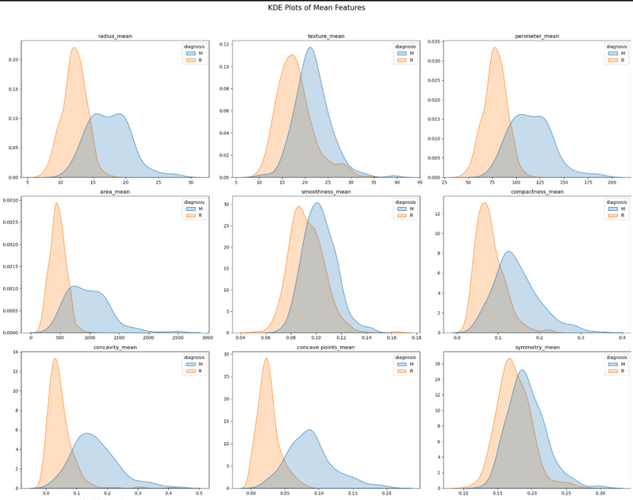
KDE Distributions
Malignant tumors tend to have larger nuclei (in terms of radius, perimeter, and area) and more irregular shapes (including concavity and concave points), making these features the most discriminative.
Texture, smoothness, symmetry, and fractal dimension show strong overlap, so they are less effective as standalone predictors but may help in combination.
Samsung Innovation Campus

Slide 12
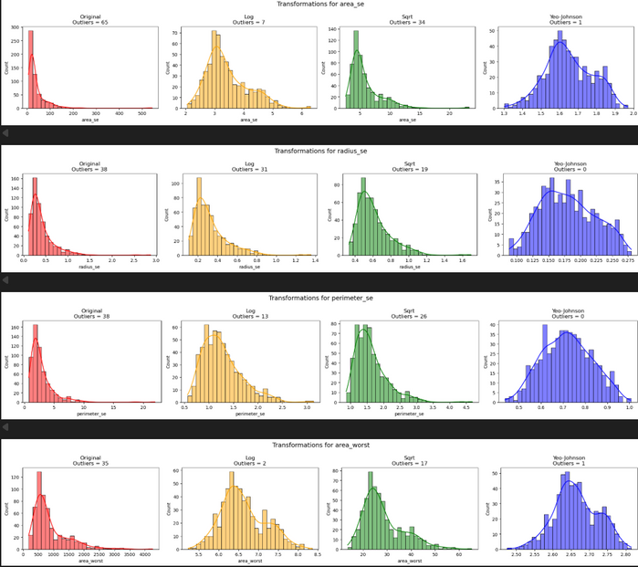
Outliers Handling
Transformation Choice for Outlier Reduction
We compared different transformations to handle outliers in the dataset.
The average number of outliers per transformation is as follows:
- Original: 20.97
- Log: 13.03
- Sqrt: 12.28
- Yeo–Johnson: 2.52
From these results, the Yeo–Johnson transformation clearly performs the best, reducing the average number of outliers to 2.52, which is significantly lower than all other methods.
Samsung Innovation Campus

Slide 13
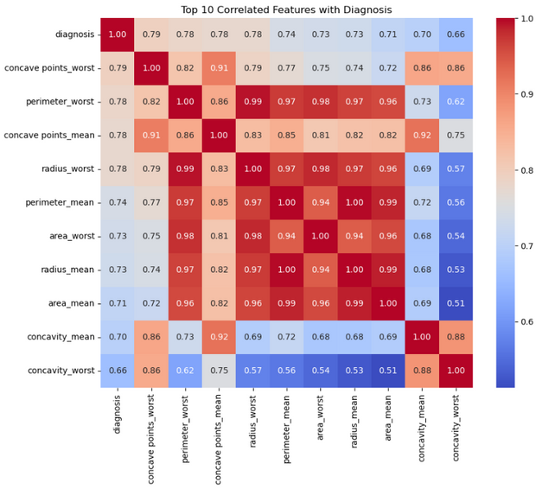
Correlations
The correlation analysis shows that many features are strongly related, especially size-based ones like radius, perimeter, and area, which often overlap in information.
The most predictive features for distinguishing malignant vs benign are concave points, concavity, radius, perimeter, and area (worst and mean values).
This means that shape and size features are the strongest indicators of cancer, while texture, smoothness, symmetry, and fractal dimension contribute less.
Because of redundancy, we don’t need all features — instead, we can apply PCA to reduce multicollinearity and improve model performance.
Samsung Innovation Campus

Slide 14
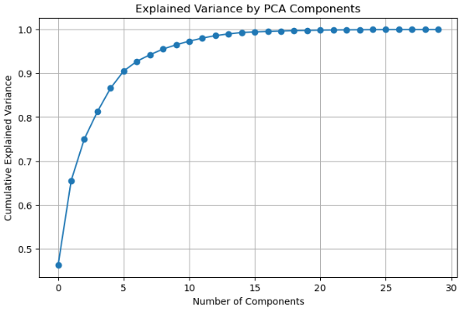
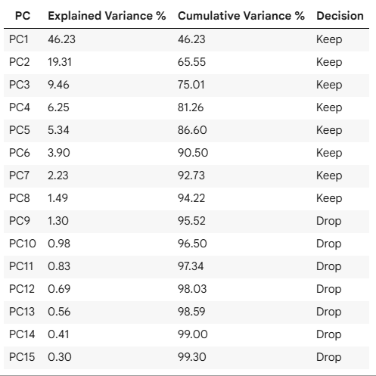
PCA
Samsung Innovation Campus

Slide 15
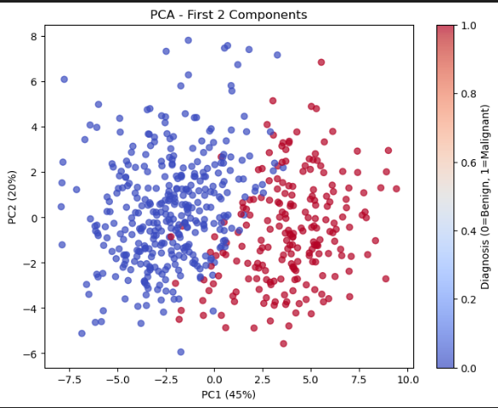
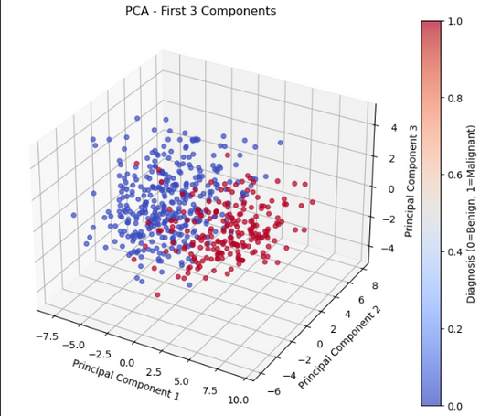
PCA
PCA with First 2 Components
Captures 65% of variability in the dataset
PCA with First 3 Components
Captures 75% of the variability in the dataset.
Samsung Innovation Campus

Slide 16
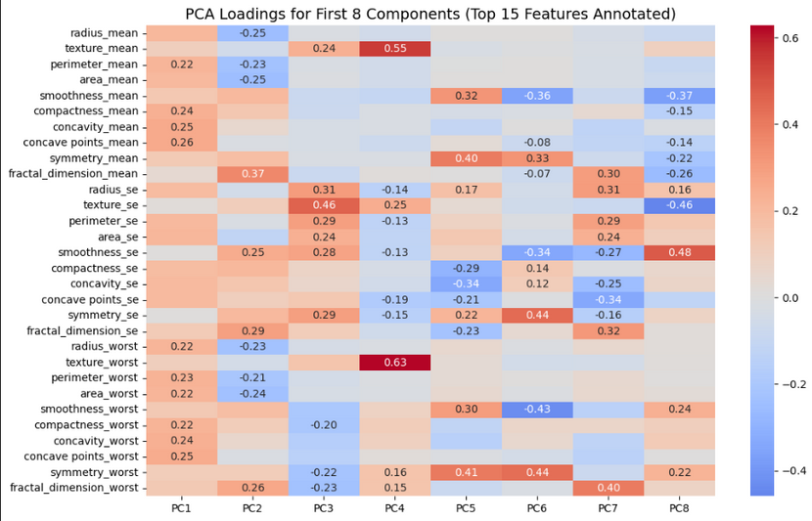
PCA
PCA Insights (PC1–PC3)
PC1: Captures tumor size and irregularity (radius, perimeter, area, concavity).
It mostly measures how big the tumor is and how irregular its shape is.
PC2: It contrasts texture-related features (like fractal dimension, smoothness) with size features (radius, perimeter, area).
This helps separate tumors based on surface quality vs. bulk size.
PC3: Highlights variation (SE features) in texture and geometry.
It measures variability within tumor features (heterogeneity).
Samsung Innovation Campus

Slide 17
Pipeline
Samsung Innovation Campus
Notes:
Note:
2

Slide 18
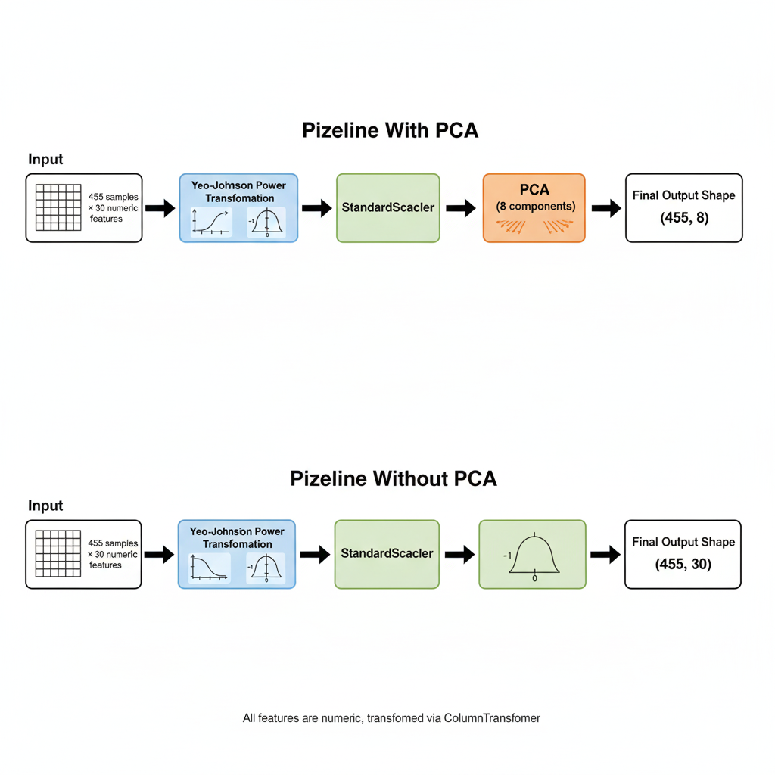
Pipeline
Splitting Features & Target
Transformations Applied
Two Pipelines With PCA & Without PCA
Column Transformer Usage
SMOTE Oversampling
Pipeline without PCA
Pipeline with PCA
Samsung Innovation Campus
Notes:
Note:
9

Slide 19
Model Selection
Samsung Innovation Campus
Notes:
Note:
2

Slide 20
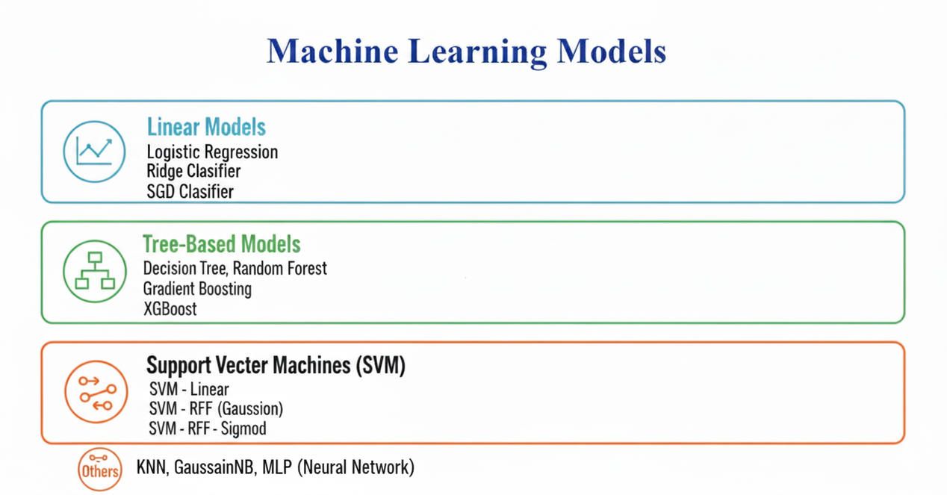
Model Selection
Ploynomial
RBF
Samsung Innovation Campus
Notes:
Note:
9

Slide 21
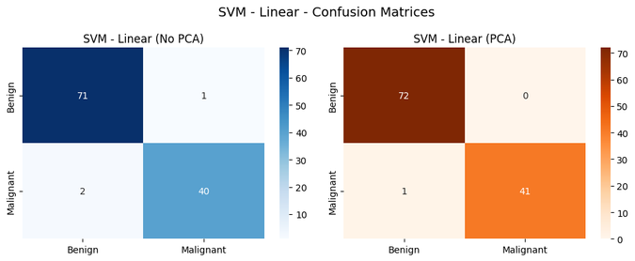
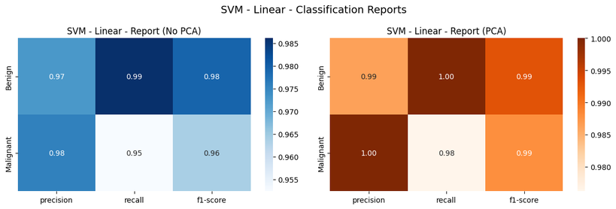
Pipeline & Model Selection
One of Top Models
Samsung Innovation Campus
Notes:
Note:
9

Slide 22
Best Model & Final Results
Samsung Innovation Campus
Notes:
Note:
2

Slide 23
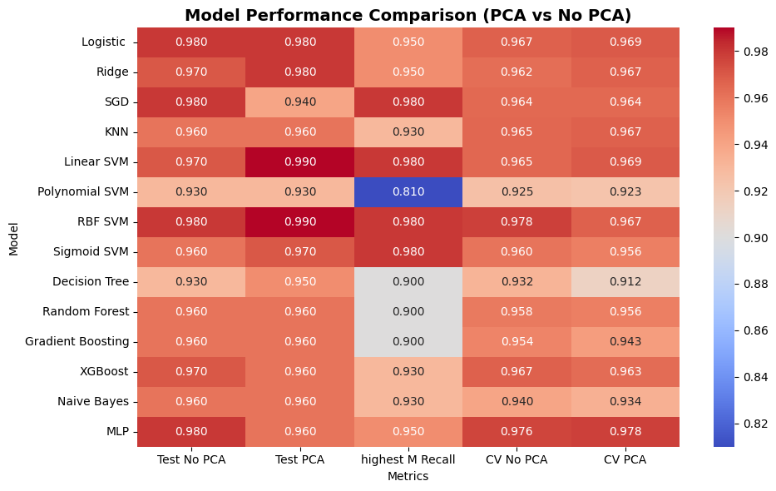
Final Results

Slide 24
Deployment
Samsung Innovation Campus
Notes:
Note:
2

Slide 25
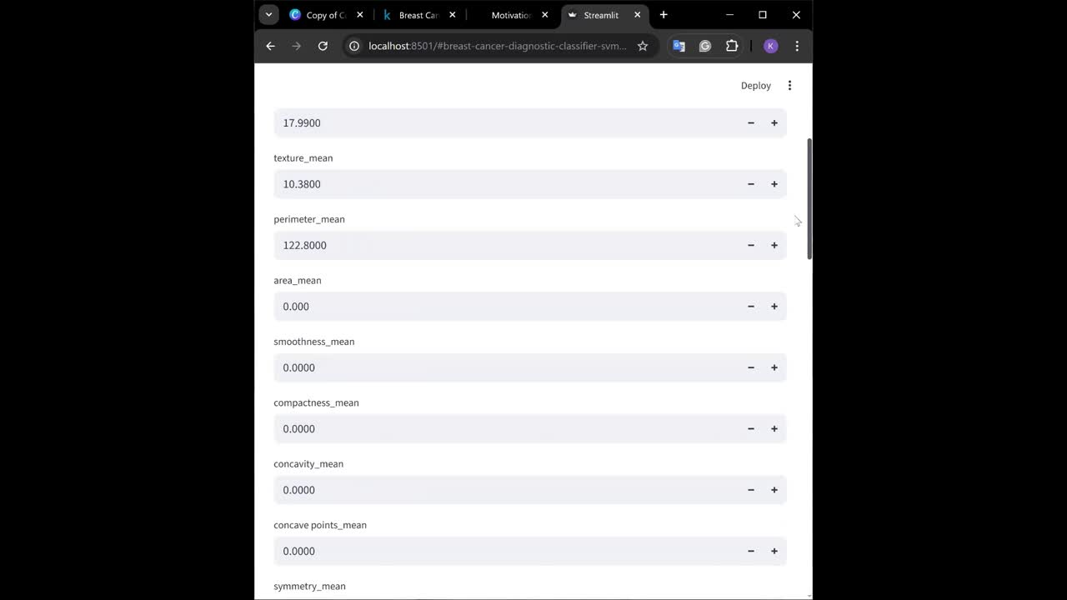
diagnosis: M
radius_mean: 17.99
texture_mean: 10.38
perimeter_mean: 122.8
area_mean: 1001
smoothness_mean: 0.1184
compactness_mean: 0.2776
concavity_mean: 0.3001
concave points_mean: 0.1471
symmetry_mean: 0.2419
fractal_dimension_mean: 0.07871
radius_se: 1.095
texture_se: 0.9053
perimeter_se: 8.589
area_se: 153.4
smoothness_se: 0.006399
compactness_se: 0.04904
concavity_se: 0.05373
concave points_se: 0.01587
symmetry_se: 0.03003
fractal_dimension_se: 0.006193
radius_worst: 25.38
texture_worst: 17.33
perimeter_worst: 184.6
area_worst: 2019
smoothness_worst: 0.1622
compactness_worst: 0.6656
concavity_worst: 0.7119
concave points_worst: 0.2654
symmetry_worst: 0.4601
fractal_dimension_worst: 0.1189

Slide 26
Future Enhancements
Samsung Innovation Campus
Notes:
Note:
2

Slide 27
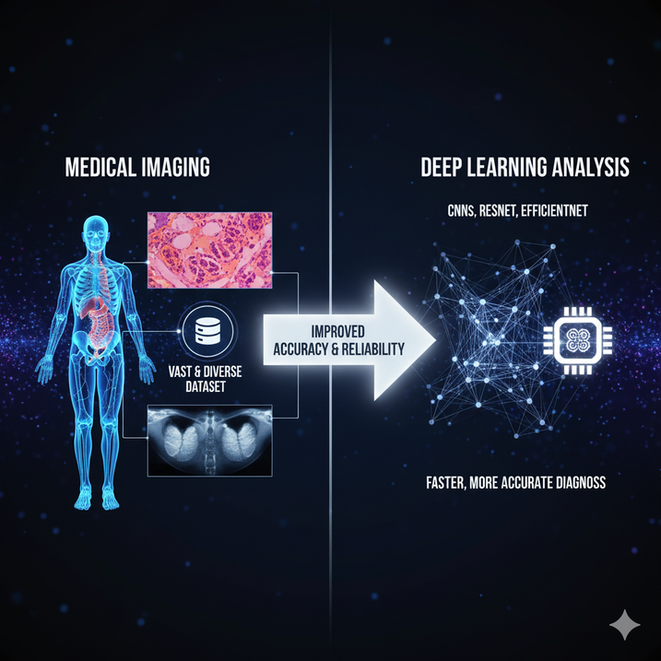
Future Enhancements
Deep Learning Models:
Using CNNs or advanced architectures (ResNet, EfficientNet) for direct image-based diagnosis can improve accuracy and reduce false negatives.
Dataset Expansion:
Training on raw medical images or larger datasets can boost generalization and reliability.
Datasets link :
Kaggle
Source
Samsung Innovation Campus

Slide 28

ⓒ2020 SAMSUNG. All rights reserved.
Samsung Electronics Corporate Citizenship Office holds the copyright of book.
This book is a literary property protected by copyright law so reprint and reproduction without permission are prohibited.
To use this book other than the curriculum of Samsung innovation Campus or to use the entire or part of this book, you must receive written consent from copyright holder.
Notes:
14

